Slide 1
Chapter 4: Logical Database Design and the Relational Model
Modern Database Management
11th Edition
Jeffrey A. Hoffer, V. Ramesh,
Heikki Topi

Slide 2
Data Normalization
Primarily a tool to validate and improve a logical design so that it satisfies certain constraints that avoid unnecessary duplication of data
The process of decomposing relations with anomalies to produce smaller, well-structured relations

Slide 3
Well-Structured Relations
A relation that contains minimal data redundancy and allows users to insert, delete, and update rows without causing data inconsistencies
Goal is to avoid anomalies
Insertion Anomaly–adding new rows forces user to create duplicate data
Deletion Anomaly–deleting rows may cause a loss of data that would be needed for other future rows
Modification Anomaly–changing data in a row forces changes to other rows because of duplication
General rule of thumb: A table should not pertain to more than one entity type.

Slide 4
Example–Figure 4-2b
Question–Is this a relation?
Answer–Yes: Unique rows and no multivalued attributes
Question–What’s the primary key?
Answer–Composite: EmpID, CourseTitle

Slide 5
Anomalies in this Table
Insertion–can’t enter a new employee without having the employee take a class (or at least empty fields of class information)
Deletion–if we remove employee 140, we lose information about the existence of a Tax Acc class
Modification–giving a salary increase to employee 100 forces us to update multiple records
Why do these anomalies exist?
Because there are two themes (entity types) in this one relation. This results in data duplication and an unnecessary dependency between the entities.

Slide 6
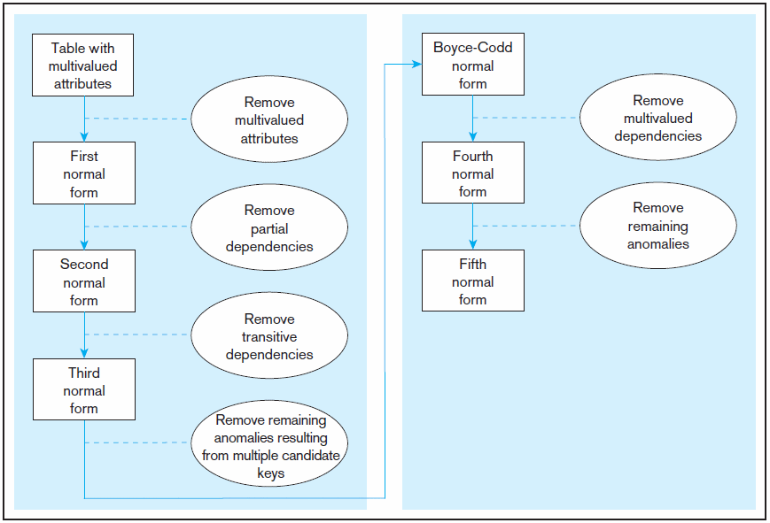
Figure 4.22 Steps in normalization
3rd normal form is generally considered sufficient
Chapter 4
© 2013 Pearson Education, Inc. Publishing as Prentice Hall
6

Slide 7
Functional Dependencies and Keys
Functional Dependency: The value of one attribute (the determinant) determines the value of another attribute
Candidate Key:
A unique identifier. One of the candidate keys will become the primary key
E.g., perhaps there is both credit card number and SS# in a table…in this case both are candidate keys.
Each non-key field is functionally dependent on every candidate key.

Slide 8
First Normal Form
No multivalued attributes
Every attribute value is atomic
Fig. 4-25 is not in 1st Normal Form (multivalued attributes) ➔ it is not a relation.
Fig. 4-26 is in 1st Normal form.
All relations are in 1st Normal Form.

Slide 9
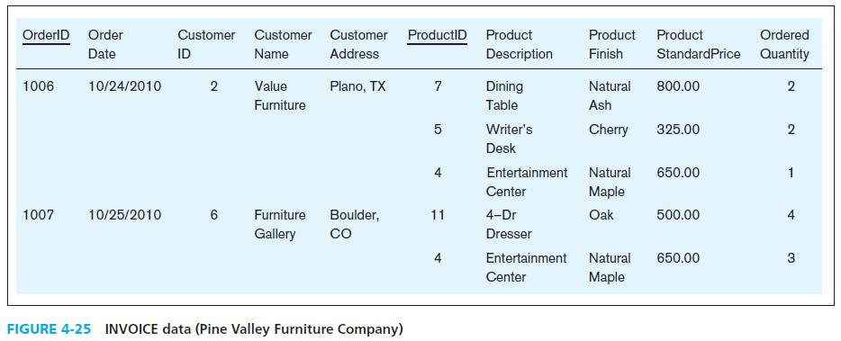
Table with multivalued attributes, not in 1st normal form
Note: This is NOT a relation.
Chapter 4
© 2013 Pearson Education, Inc. Publishing as Prentice Hall
9

Slide 10
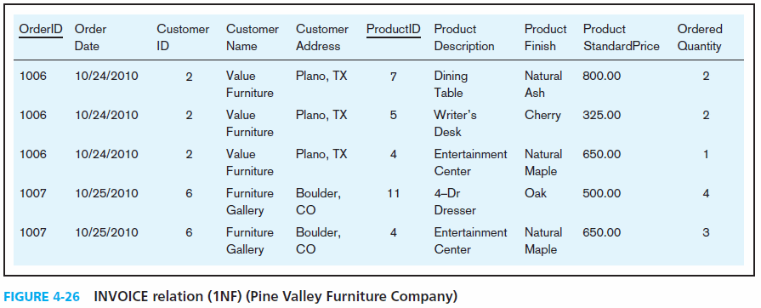
Table with no multivalued attributes and unique rows, in 1st normal form
Note: This is a relation, but not a well-structured one.
Chapter 4
© 2013 Pearson Education, Inc. Publishing as Prentice Hall
10

Slide 11
Anomalies in this Table
Insertion–if new product is ordered for order 1007 of existing customer, customer data must be re-entered, causing duplication
Deletion–if we delete the Dining Table from Order 1006, we lose information concerning this item’s finish and price
Update–changing the price of product ID 4 requires update in multiple records
Why do these anomalies exist?
Because there are multiple themes (entity types) in one relation. This results in duplication and an unnecessary dependency between the entities.

Slide 12
Second Normal Form
1NF PLUS every non-key attribute is fully functionally dependent on the ENTIRE primary key
Every non-key attribute must be defined by the entire key, not by only part of the key
No partial functional dependencies

Slide 13
Figure 4-27 Functional dependency diagram for INVOICE
OrderID ➔ OrderDate, CustomerID, CustomerName, CustomerAddress
CustomerID ➔ CustomerName, CustomerAddress
ProductID ➔ ProductDescription, ProductFinish, ProductStandardPrice
OrderID, ProductID ➔ OrderQuantity
Therefore, NOT in 2nd Normal Form

Slide 14
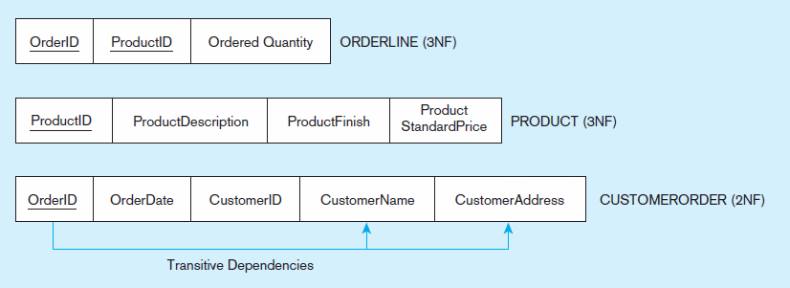
Figure 4-28 Removing partial dependencies
Getting it into Second Normal Form
Partial dependencies are removed, but there are still transitive dependencies

Slide 15
Third Normal Form
2NF PLUS no transitive dependencies (functional dependencies on non-primary-key attributes)
Note: This is called transitive, because the primary key is a determinant for another attribute, which in turn is a determinant for a third
Solution: Non-key determinant with transitive dependencies go into a new table; non-key determinant becomes primary key in the new table and stays as foreign key in the old table

Slide 16
Figure 4-29 Removing partial dependencies
Getting it into Third Normal Form
Transitive dependencies are removed.

Slide 17
Merging Relations
View Integration–Combining entities from multiple ER models into common relations
Issues to watch out for when merging entities from different ER models:
Synonyms–two or more attributes with different names but same meaning
Homonyms–attributes with same name but different meanings
Transitive dependencies–even if relations are in 3NF prior to merging, they may not be after merging
Supertype/subtype relationships–may be hidden prior to merging

Slide 18
Enterprise Keys
Primary keys that are unique in the whole database, not just within a single relation
Corresponds with the concept of an object ID in object-oriented systems

Slide 19
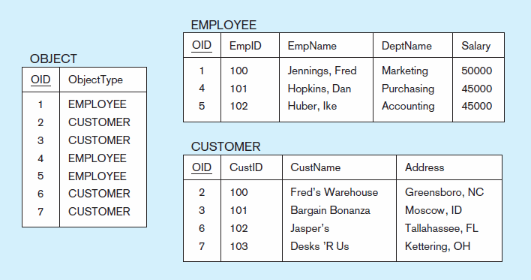
Figure 4-31 Enterprise keys
a) Relations with enterprise key
b) Sample data with enterprise key
Chapter 4
© 2013 Pearson Education, Inc. Publishing as Prentice Hall
19

Slide 20
Copyright © 2011 Pearson Education, Inc. Publishing as Prentice Hall
20

