Slide 1
Chapter 4: Logical Database Design and the Relational Model
Modern Database Management
11th Edition
Jeffrey A. Hoffer, V. Ramesh,
Heikki Topi

Slide 2
Objectives
Define terms
List five properties of relations
State two properties of candidate keys
Define first, second, and third normal form
Describe problems from merging relations
Transform E-R and EER diagrams to relations
Create tables with entity and relational integrity constraints
Use normalization to convert anomalous tables to well-structured relations

Slide 3
Components of relational model
Data structure
Tables (relations), rows, columns
Data manipulation
Powerful SQL operations for retrieving and modifying data
Data integrity
Mechanisms for implementing business rules that maintain integrity of manipulated data

Slide 4
Relation
A relation is a named, two-dimensional table of data.
A table consists of rows (records) and columns (attribute or field).
Requirements for a table to qualify as a relation:
It must have a unique name.
Every attribute value must be atomic (not multivalued, not composite).
Every row must be unique (can’t have two rows with exactly the same values for all their fields).
Attributes (columns) in tables must have unique names.
The order of the columns must be irrelevant.
The order of the rows must be irrelevant.
NOTE: All relations are in 1st Normal form.

Slide 5
Correspondence with E-R Model
Relations (tables) correspond with entity types and with many-to-many relationship types.
Rows correspond with entity instances and with many-to-many relationship instances.
Columns correspond with attributes.
NOTE: The word relation (in relational database) is NOT the same as the word relationship (in E-R model).

Slide 6
Key Fields
Keys are special fields that serve two main purposes:
Primary keys are unique identifiers of the relation. Examples include employee numbers, social security numbers, etc. This guarantees that all rows are unique.
Foreign keys are identifiers that enable a dependent relation (on the many side of a relationship) to refer to its parent relation (on the one side of the relationship).
Keys can be simple (a single field) or composite (more than one field).
Keys usually are used as indexes to speed up the response to user queries (more on this in Chapter 5).

Slide 7
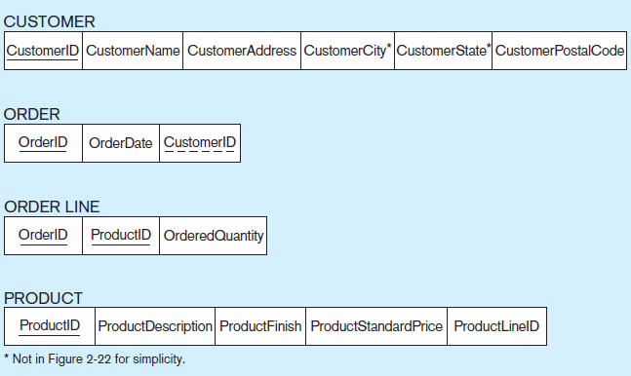
Figure 4-3 Schema for four relations (Pine Valley Furniture Company)
Primary Key
Foreign Key (implements 1:N relationship between customer and order)
Combined, these are a composite primary key (uniquely identifies the order line)…individually they are foreign keys (implement M:N relationship between order and product)
Chapter 4
© 2013 Pearson Education, Inc. Publishing as Prentice Hall
7

Slide 8
Integrity Constraints
Domain Constraints
Allowable values for an attribute (See Table 4-1)
Entity Integrity
No primary key attribute may be null. All primary key fields MUST have data.
Action Assertions
Business rules (Recall from Chapter 3)

Slide 9
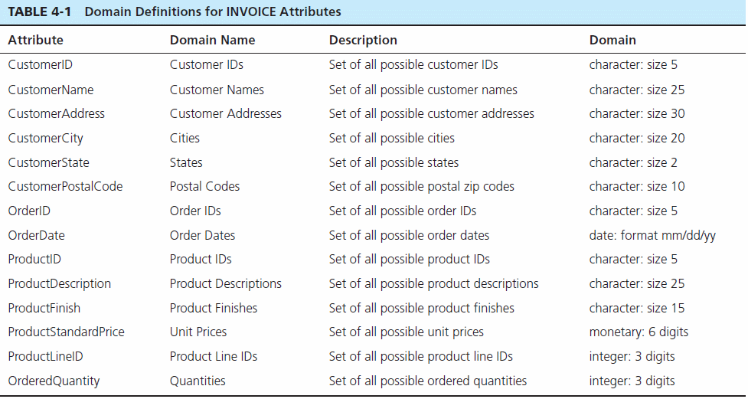
Domain definitions enforce domain integrity constraints.
Chapter 4
© 2013 Pearson Education, Inc. Publishing as Prentice Hall
9

Slide 10
Integrity Constraints
Referential Integrity–rule states that any foreign key value (on the relation of the many side) MUST match a primary key value in the relation of the one side. (Or the foreign key can be null)
For example: Delete Rules
Restrict–don’t allow delete of “parent” side if related rows exist in “dependent” side
Cascade–automatically delete “dependent” side rows that correspond with the “parent” side row to be deleted
Set-to-Null–set the foreign key in the dependent side to null if deleting from the parent side → not allowed for weak entities

Slide 11
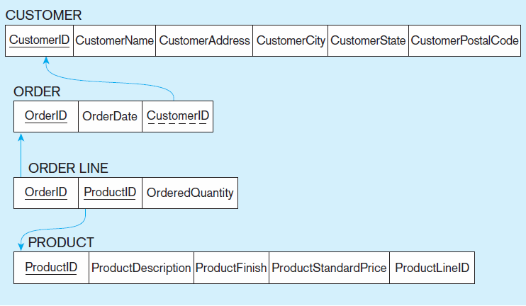
Figure 4-5
Referential integrity constraints (Pine Valley Furniture)
Referential integrity constraints are drawn via arrows from dependent to parent table
Chapter 4
© 2013 Pearson Education, Inc. Publishing as Prentice Hall
11

Slide 12
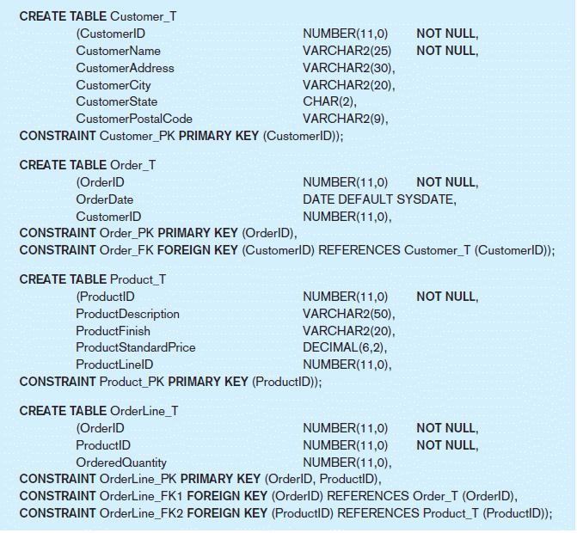
Figure 4-6 SQL table definitions
Referential integrity constraints are implemented with foreign key to primary key references.
Chapter 4
© 2013 Pearson Education, Inc. Publishing as Prentice Hall

Slide 13
Transforming EER Diagrams into Relations
Mapping Regular Entities to Relations
Simple attributes: E-R attributes map directly onto the relation
Composite attributes: Use only their simple, component attributes
Multivalued Attribute: Becomes a separate relation with a foreign key taken from the superior entity

Slide 14
Figure 4-8 Mapping a regular entity
(a) CUSTOMER entity type with simple attributes
(b) CUSTOMER relation
Chapter 4
© 2013 Pearson Education, Inc. Publishing as Prentice Hall
14

Slide 15
Figure 4-9 Mapping a composite attribute
(a) CUSTOMER entity type with composite attribute
(b) CUSTOMER relation with address detail
Chapter 4
© 2013 Pearson Education, Inc. Publishing as Prentice Hall
15

Slide 16
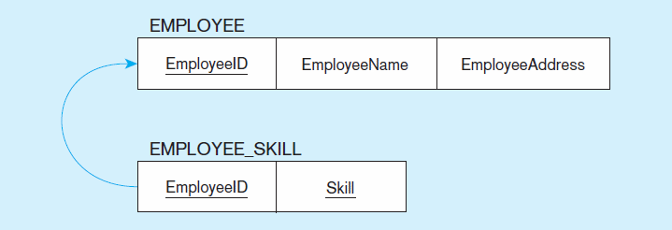
Figure 4-10 Mapping an entity with a multivalued attribute
(a)
Multivalued attribute becomes a separate relation with foreign key
(b)
One–to–many relationship between original entity and new relation

Slide 17
Transforming EER Diagrams into Relations (cont.)
Mapping Weak Entities
Becomes a separate relation with a foreign key taken from the superior entity
Primary key composed of:
Partial identifier of weak entity
Primary key of identifying relation (strong entity)

Slide 18
Figure 4-11 Example of mapping a weak entity
a) Weak entity DEPENDENT
Chapter 4
© 2013 Pearson Education, Inc. Publishing as Prentice Hall
18

Slide 19
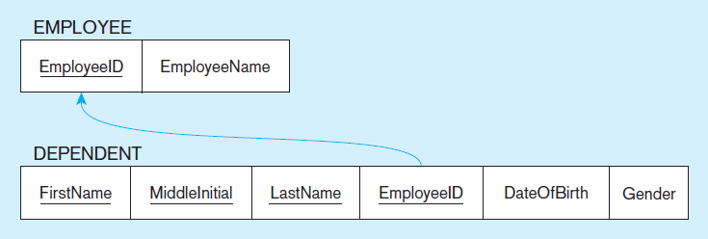
Figure 4-11 Example of mapping a weak entity (cont.)
b) Relations resulting from weak entity
NOTE: the domain constraint for the foreign key should NOT allow null value if DEPENDENT is a weak entity
Foreign key
Composite primary key
Chapter 4
© 2013 Pearson Education, Inc. Publishing as Prentice Hall
19

Slide 20
Transforming EER Diagrams into Relations (cont.)
Mapping Binary Relationships
One-to-Many–Primary key on the one side becomes a foreign key on the many side
Many-to-Many–Create a new relation with the primary keys of the two entities as its primary key
One-to-One–Primary key on mandatory side becomes a foreign key on optional side

Slide 21
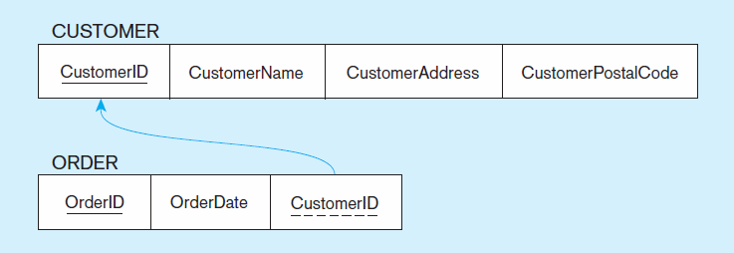
Figure 4-12 Example of mapping a 1:M relationship
a) Relationship between customers and orders
Note the mandatory one
b) Mapping the relationship
Again, no null value in the foreign key…this is because of the mandatory minimum cardinality.
Foreign key
Chapter 4
© 2013 Pearson Education, Inc. Publishing as Prentice Hall
21

Slide 22
Figure 4-13 Example of mapping an M:N relationship
a) Completes relationship (M:N)
The Completes relationship will need to become a separate relation.
Chapter 4
© 2013 Pearson Education, Inc. Publishing as Prentice Hall
22

Slide 23
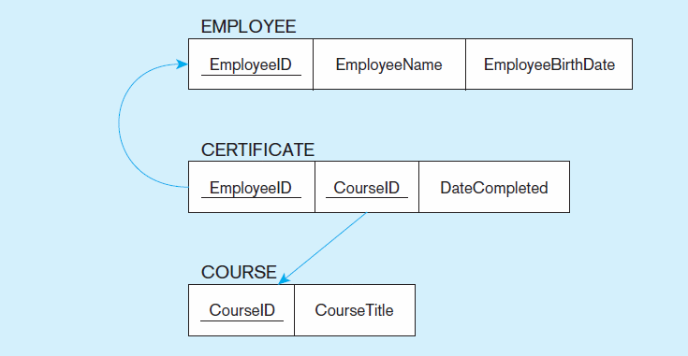
Figure 4-13 Example of mapping an M:N relationship (cont.)
b) Three resulting relations
Composite primary key
Foreign key
new intersection relation
Foreign key
Chapter 4
© 2013 Pearson Education, Inc. Publishing as Prentice Hall
23

Slide 24
Figure 4-14 Example of mapping a binary 1:1 relationship
a) In charge relationship (1:1)
Often in 1:1 relationships, one direction is optional
Chapter 4
© 2013 Pearson Education, Inc. Publishing as Prentice Hall
24

Slide 25
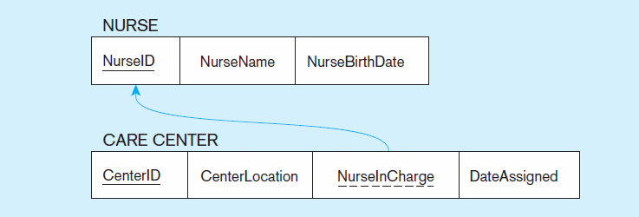
Figure 4-14 Example of mapping a binary 1:1 relationship (cont.)
b) Resulting relations
Foreign key goes in the relation on the optional side,
matching the primary key on the mandatory side
Chapter 4
© 2013 Pearson Education, Inc. Publishing as Prentice Hall
25

Slide 26
Transforming EER Diagrams into Relations (cont.)
Mapping Associative Entities
Identifier Not Assigned
Default primary key for the association relation is composed of the primary keys of the two entities (as in M:N relationship)
Identifier Assigned
It is natural and familiar to end-users
Default identifier may not be unique

Slide 27
Figure 4-15 Example of mapping an associative entity
a) An associative entity
Chapter 4
© 2013 Pearson Education, Inc. Publishing as Prentice Hall
27

Slide 28
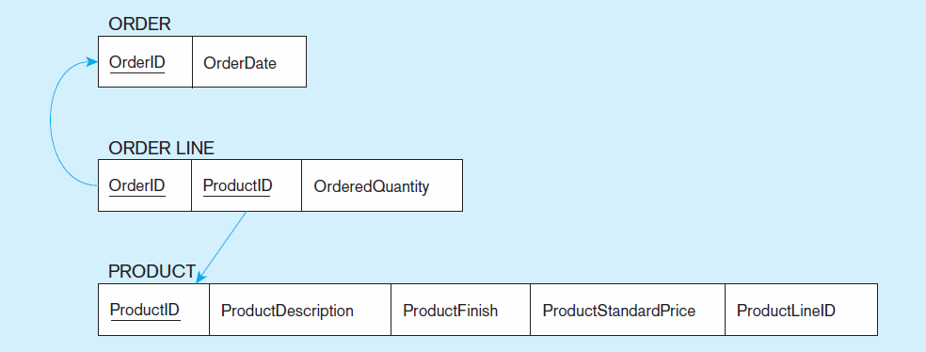
Figure 4-15 Example of mapping an associative entity (cont.)
b) Three resulting relations
Composite primary key formed from the two foreign keys
Chapter 4
© 2013 Pearson Education, Inc. Publishing as Prentice Hall
28

Slide 29
Figure 4-16 Example of mapping an associative entity with
an identifier
a) SHIPMENT associative entity
Chapter 4
© 2013 Pearson Education, Inc. Publishing as Prentice Hall
29

Slide 30
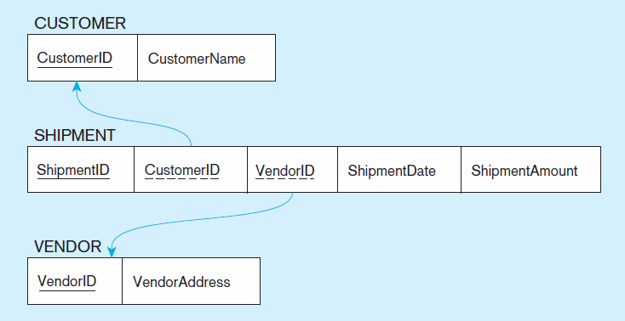
Figure 4-16 Example of mapping an associative entity with
an identifier (cont.)
b) Three resulting relations
Primary key differs from foreign keys
Chapter 4
© 2013 Pearson Education, Inc. Publishing as Prentice Hall
30

Slide 31
Transforming EER Diagrams into Relations (cont.)
Mapping Unary Relationships
One-to-Many–Recursive foreign key in the same relation
Many-to-Many–Two relations:
One for the entity type
One for an associative relation in which the primary key has two attributes, both taken from the primary key of the entity

Slide 32
Figure 4-17 Mapping a unary 1:N relationship
(a) EMPLOYEE entity with unary relationship
(b) EMPLOYEE relation with recursive foreign key
Chapter 4
© 2013 Pearson Education, Inc. Publishing as Prentice Hall
32

Slide 33
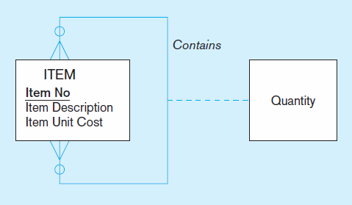
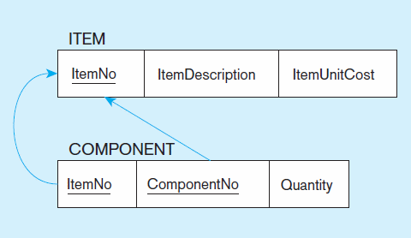
Figure 4-18 Mapping a unary M:N relationship
(a) Bill-of-materials relationships (M:N)
(b) ITEM and COMPONENT relations

Slide 34
Transforming EER Diagrams into Relations (cont.)
Mapping Ternary (and n-ary) Relationships
One relation for each entity and one for the associative entity
Associative entity has foreign keys to each entity in the relationship

Slide 35
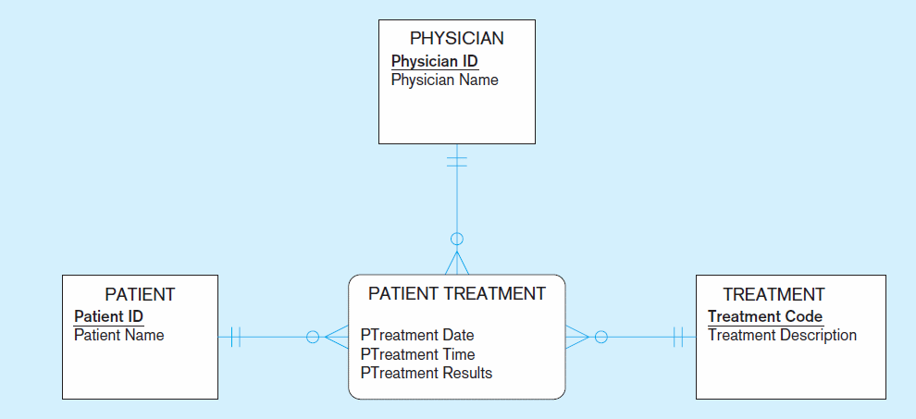
Figure 4-19 Mapping a ternary relationship
a) PATIENT TREATMENT Ternary relationship with associative entity
Chapter 4
© 2013 Pearson Education, Inc. Publishing as Prentice Hall
35

Slide 36
Figure 4-19 Mapping a ternary relationship (cont.)
b) Mapping the ternary relationship PATIENT TREATMENT
Remember that the primary key MUST be unique.
This is why treatment date and time are included in the composite primary key.
But this makes a very cumbersome key…
It would be better to create a surrogate key like Treatment#.
Chapter 4
© 2013 Pearson Education, Inc. Publishing as Prentice Hall
36

Slide 37
Transforming EER Diagrams into Relations (cont.)
Mapping Supertype/Subtype Relationships
One relation for supertype and for each subtype
Supertype attributes (including identifier and subtype discriminator) go into supertype relation
Subtype attributes go into each subtype; primary key of supertype relation also becomes primary key of subtype relation
1:1 relationship established between supertype and each subtype, with supertype as primary table

Slide 38
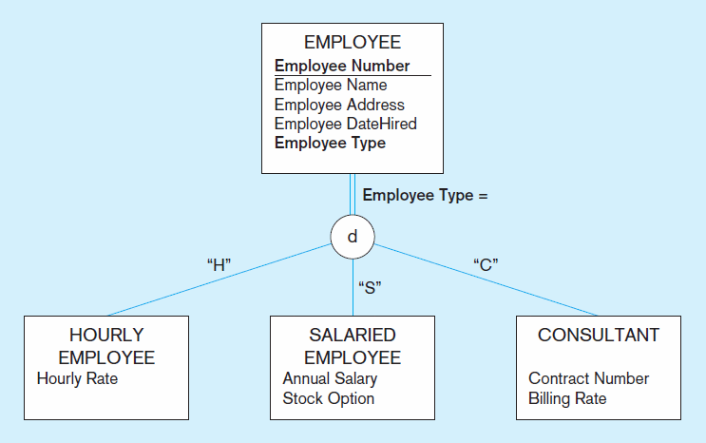
Figure 4-20 Supertype/subtype relationships
Chapter 4
© 2013 Pearson Education, Inc. Publishing as Prentice Hall
38

Slide 39
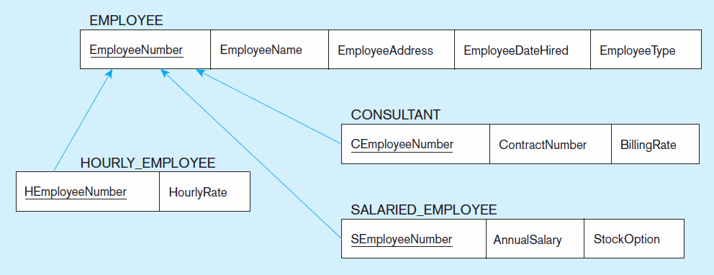
Figure 4-21
Mapping supertype/subtype relationships to relations
These are implemented as one-to-one relationships.
Chapter 4
© 2013 Pearson Education, Inc. Publishing as Prentice Hall
39

